Slide 1


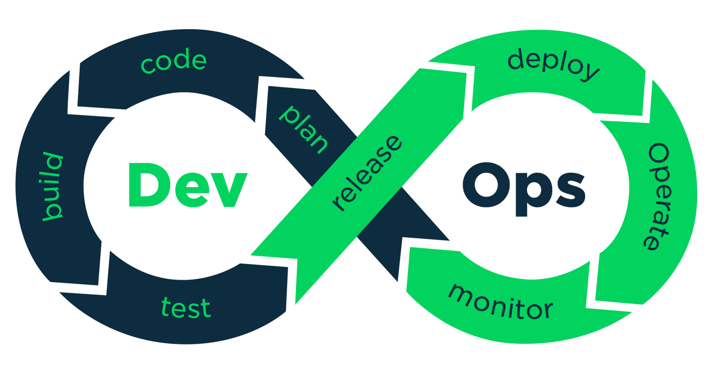
DevOps
PRESENTATION
Manish Kumar Sharma
Mohit Malik
Namit Kumar
19CSU173
19CSU179
19CSU185

Slide 2

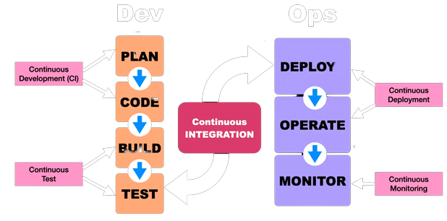
WHAT IS DEVOPS?
DevOps is a software development methodology that combines software development(Dev) with Information technology Operations participating together in the entire service lifecycle, from design through the development process to production support.

Slide 3


BEFORE DEVOPS
Classic Waterfall Model
Iterative Waterfall Model
1
2
Obsolete Model - Not used anymore because of many drawbacks.
Enhanced classical waterfall model but still not used much.
V-Shaped Model
Evolutionary Model
3
4
Involves Testing(Verification and Validation) throughout the Dev process.
Involves breakdown of requirements and release software in different versions.
Prototyping Model
Incremental Model
5
6
Creating a Prototype for understanding requirements in a better way.
Involves breakdown and prioritization of req & release software in diff versions.
Spiral Model
Rapid App Development
7
8
Handles real time risks, complex and large systems.
The whole process is automated with the help of tools to reduce development time.

Slide 4

According to an IT Survey, Software built by these Conventional Models were dropped because of the following reasons
39%
28%
Business Requirements changed - 1/4th of initial requirements changed during the completion of development phase
Did not deliver as promised - Companies fail to deliver projects as expected by the client
Drawbacks
22%
11%
Project exceeded the budget - As analyzed in feasibility analysis
Project did not support the business strategies and few other reasons.

Slide 5

Agile provides us a set of values & principles which helps us in making decisions .it doesn’t make decisions for you, instead it gives a foundation to make decisions that result in better software development.
Agile Model
It's not just a process model,
It's a Mindset
Our highest priority is to satisfy customer with welcoming changing requirements. working software is primary, measure of progress.
Simplicity–the art of maximizing the amount of work not done–is essential.

Slide 6
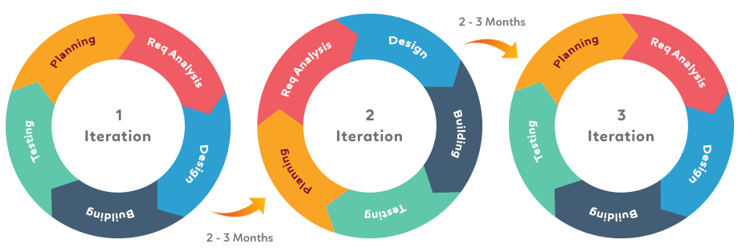
Agile Iterations
Agile Methodology is a combination of iterative & incremental process.
It works in sprint/iteration with time box approach, same set of phases we will be using in each iteration.
Both development & testing team can work concurrently which was not possible in previous models.

Slide 7

Limitations of Agile
Poor Resource Planning
Teams won’t know what their result will look like. For even small changes we must execute whole sprint
No Finite end
Limited documentation
Due to dynamic issues or problems, projects have no finite end, as there is never a clear vision of what the “final product” looks like.
Documentation happens throughout a project, not at the beginning. As a result, it becomes less detailed and often falls to the back burner.
Fragmented output
Difficult measurement
Teams work on each component in different cycles, the complete output often becomes very fragmented rather than one cohesive unit.
Tracking progress requires you to look across cycles. That long game makes measuring progress difficult.

Slide 8


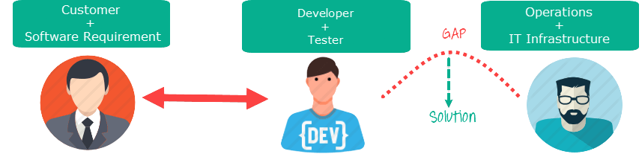

Agile is focused on getting smaller teams to collaborate with each other so it can react quickly to the ever-changing consumer needs, whereas DevOps brings development & operational teams together to allow for quicker software releases which helps to resolve the fragmented output problem.
Why Devops over Agile
The target area of Agile is Software development whereas the Target area of DevOps is to give end-to-end business solutions and fast delivery
Due to Continuous integration in DevOps the teams know how their software will look like & can quickly fix a bug without repeating whole lifecycle processes.
DEVOPS

Slide 9
VARIOUS PHASES OF
DEVOPS LIFECYCLE

Slide 10


Plan Phase
The Plan stage covers everything that happens before the developers start writing code.
Techniques & Technologies are decided for the project like dependencies & their versions to be used.
Requirements and feedback are gathered from stakeholders/customers and used to build a product roadmap to guide future development.

Slide 11
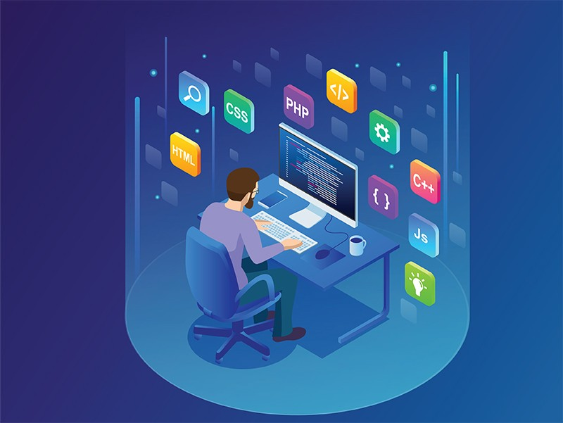
Code Phase
Once done with planning, the developers can get to work. In addition to the standard toolkit of a software developer, the team has a standard set of plugins installed in their development environments to aid the development process.
These tools also help resolve issues that may fail tests later in the pipeline, resulting in fewer failed builds.

Slide 12

Build Phase
The Build phase is where DevOps really kicks in. Once a developer has finished a task, they commit their code to a shared code repository where other developers review & send it for testing if
Simultaneously, the pull request triggers an automated process which builds the codebase and runs a series of end-to-end, integration and unit tests to identify any regressions. If the build fails, or any of the tests fail, the pull-request fails and the developer is notified to resolve the issue.

Slide 13
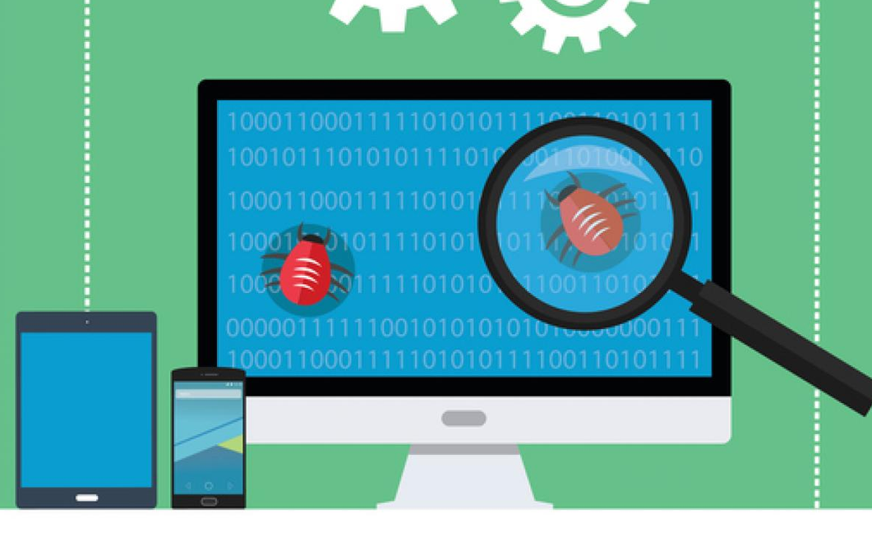
Test Phase
Once a build succeeds, it is automatically deployed to a staging environment for deeper, out-of-band testing.
Once the application is deployed to the test environment, a series of manual and automated tests are performed.
The testing that is performed during this phase is up to the organization and what is relevant to the application, but this stage can be considered a test-bed that lets you plug in new testing without interrupting the flow of developers or impacting the production environment.

Slide 14
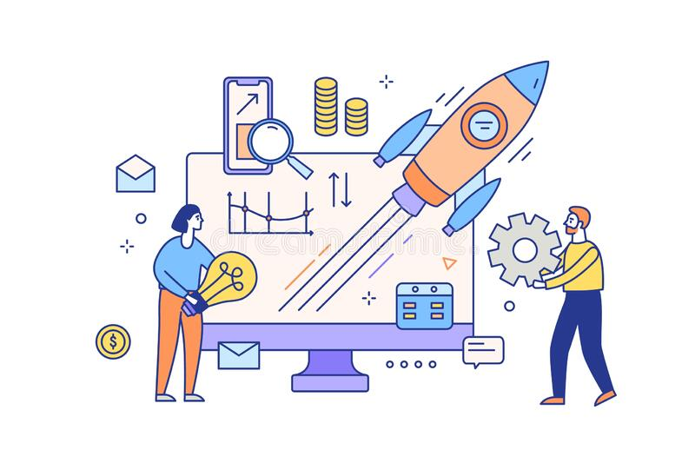
Release Phase
The Release phase is a milestone in a DevOps pipeline — it’s the point at which we say a build is ready for deployment into the production environment. By this stage, each code change has passed a series of manual and automated tests, and the operations team can be confident that breaking issues and regressions are unlikely.
Depending on the DevOps maturity of an organization, they may choose to release the application automatically or may take control over the releases.

Slide 15

Deploy Phase
Deployment involves moving software from one controlled environment to another after release stage.
When the new environment is ready, the hosting service points all new requests to the new environment. If at any point, an issue is found with the new build, you can simply tell the hosting service to point requests back to the old environment while you come up with a fix.
Deploy

Slide 16

Operate Phase
The operations team is now hard at work, making sure that everything is running smoothly. Based on the configuration of the hosting service, the environment automatically scales with load to handle peaks and troughs in the number of active users.
The organization has also built a way for their customers to provide feedback on their service, as well as tooling that helps collect and triage this feedback to help shape the future development of the product.

Slide 17
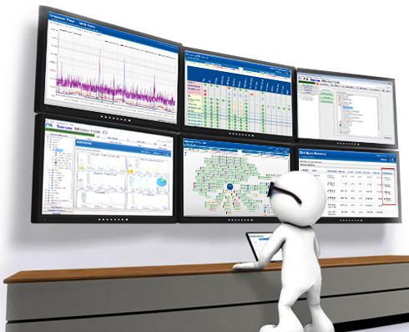
Monitor Phase
The ‘final’ phase of the DevOps cycle is to monitor the environment. this builds on the customer feedback provided in the Operate phase by collecting data and providing analytics on customer behavior, performance, errors and more.
All of this information is then fed back to the Product Manager and the development team to close the loop on the process.

Slide 18
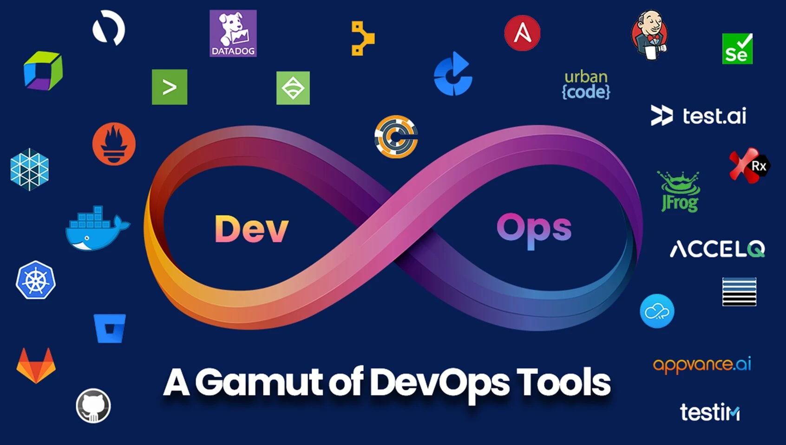

Slide 19

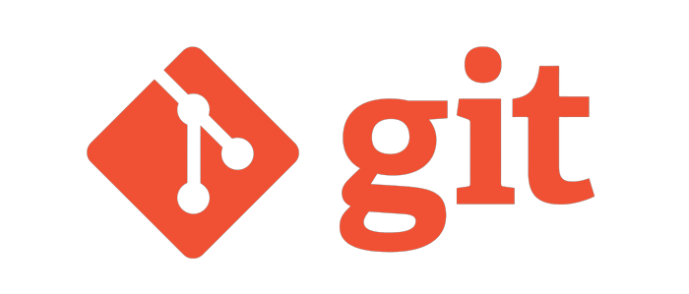
Git
Git is a DevOps tool used for source code management. It is a free and open-source version control system used to handle small to very large projects efficiently. Git is also used to track changes in the source code, enabling multiple developers to work together on non-linear development.
SVN, Azure DevOps Server and Mercurial are few Git alternatives.

Slide 20

GitHub
GitHub is a cloud-based Git repository hosting service. It provides you a powerful platform to collaborate, review and manage your code with almost anyone across the globe, ensuring that every version of the code stays intact. It allows collaborators, developers to commit (code push request) and merge their codes on the central repository once the code has met all the requirements, bug fixes or all the change requests are completed. Thus GitHub facilitates easy collaboration and efficient version control of the source code.
GitLab , BitBucket, GitBucket, Sourceforge are the most commonly used GitHub alternatives.

Slide 21

Jenkins
Jenkins is an open-source automation tool written in Java with plugins built for Continuous Integration purposes. Jenkins is used to build and test your software projects continuously making it easier for developers to integrate changes to the project, and making it easier for users to obtain a fresh build. It also allows you to continuously deliver your software by integrating with a large number of testing and deployment technologies. Jenkins has more than 2000 plugins that's why it most popular integration tool.
CircleCI and GitHub Actions can be used as Jenkins Alternative

Slide 22

Maven
It is a Universal software build tool by Apache Software Foundation. Maven is framework which addresses two aspects of building software. First, it describes how a software is built & second it describes its dependencies.
Generating Source code
Generate documentation for the source code
Compile the source code
Install the package code in local repo, server repo or central repo.
Gradle and Cmake are the also used as build tool

Slide 23

Ansible
Ansible is an open-source IT automation engine that automates provisioning, configuration management, application deployment, orchestration, and many other IT processes.
Use Ansible automation to install software, automate daily tasks, provision infrastructure, improve security and compliance, patch systems, and share automation across your organization
Ansible’s most powerful feature of creating playbooks, a small piece of YAML code, is used to automate almost anything related to your IT requirements.
Rudder & SaltStack are the most common alternatives of Ansible

Slide 24
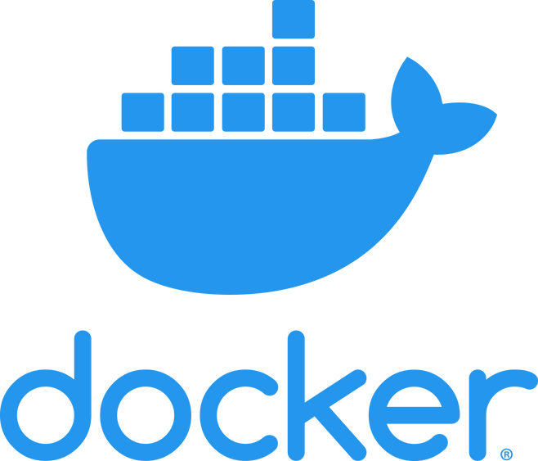
Docker
Docker generates image files which can be executed on any operating system which can run docker engine. This image file can launch multiple containers in the system without being dependent on local system which makes it OS independent. These containers contain all prerequisite like dependencies & plugins within it which helps in executing the application independently.
Applications are transforming from monolithic approach towards microservice which reduce dependency & docker help in achieving this.
Podman and Virtual Box are two major competitors of Docker.

Slide 25
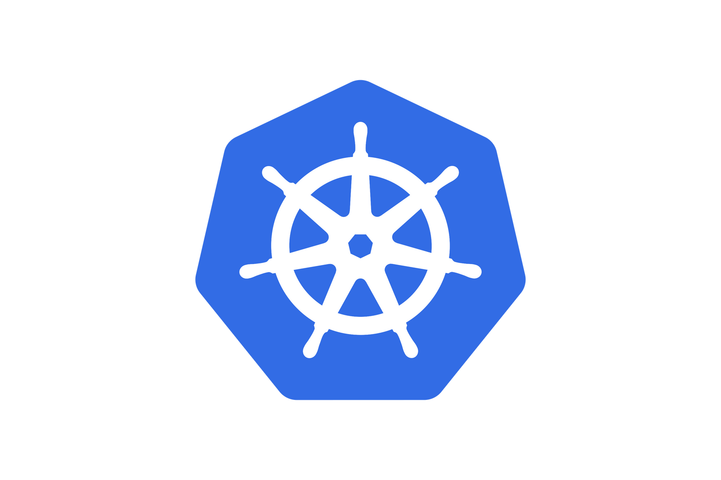
Kubernetes
Kubernetes allows companies to harness more computing power when running software applications. It automates the deployment, scheduling, and operation of application containers on clusters of machines—often hundreds of thousands or more—in private, cloud or hybrid environments. It also allows developers to create a “container-centric” environment with container images deployed on Kubernetes or integrate with a continuous integration (CI) system.
AWS Fargate, Google Cloud Run are few alternatives of Kubernetes.

Slide 26




The Team
Manish
Mohit
Namit
19CSU173
19CSU179
19CSU185

Slide 27


Slide 28
Thank You

